Slide 1
Coffee Drinking Habits of UMN Students
By: Keely Kleopfer

Slide 2
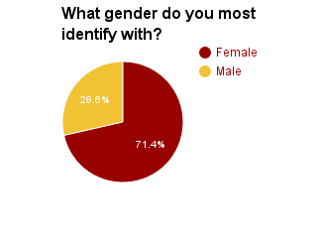
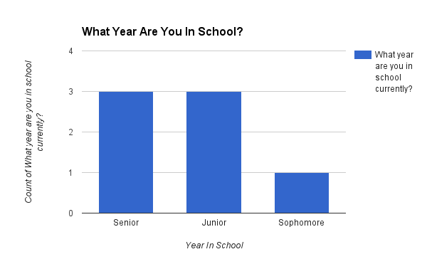
Demographics
Gender: 5 females, 2 males
Year in School: 1 Sophomore, 3 Juniors and 3 Seniors

Slide 3
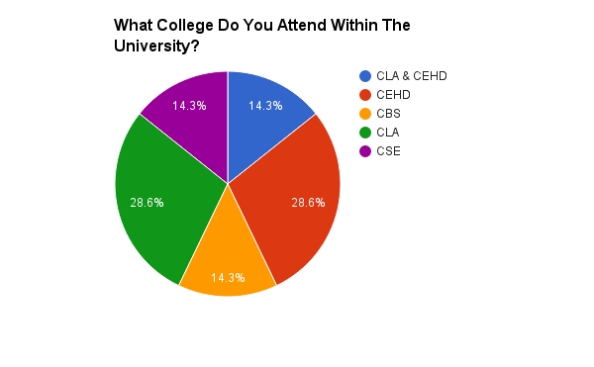
What College are you in?
Of the seven participants, one individual was in two colleges while the rest of the participants were in one college.
CLA & CEHD: 1
CLA: 2
CEHD: 2
CBS: 1
CSE: 1

Slide 4
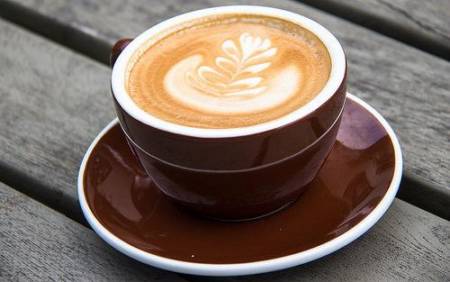
Do you drink coffee?
Of the seven participants in the survey, 100% of the individuals drink coffee.

Slide 5
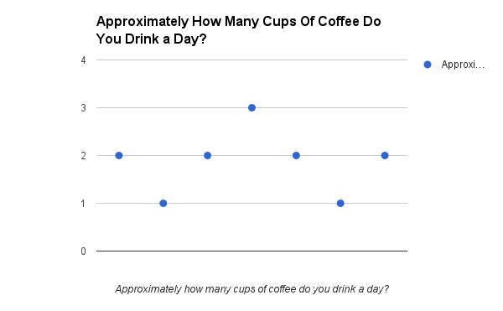
Cups of coffee consumed each day
As you can see, 2 cups
of coffee is the average
number consumed in a day.
Results:
1 cup: 2 people
2 cups: 4 people
3 cups: 1 person

Slide 6
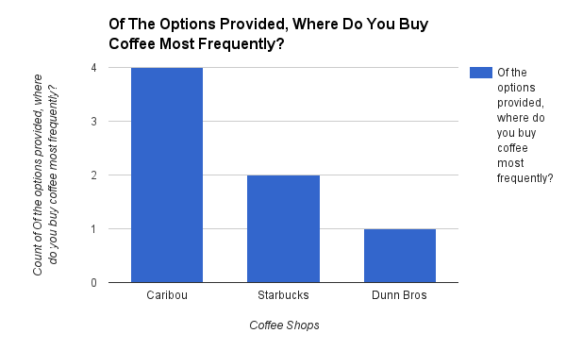
Preferred Coffee Shops

Slide 7
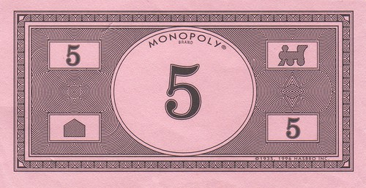
Money Spent On Coffee Each Week
The lowest number of money spent on coffee each week was $0(1 respondent). The average number of money spent on coffee each week was $5 with five respondents. Lastly the most of money spent on coffee each week was $10 (one respondent).

Slide 8
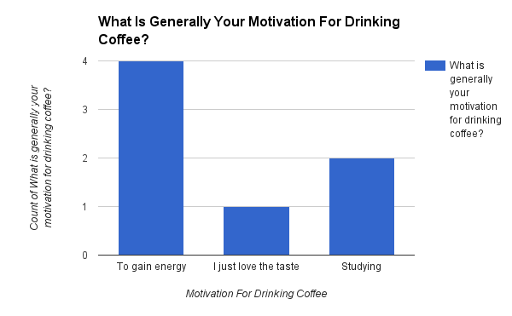
Motivation For Drinking Coffee

Slide 9
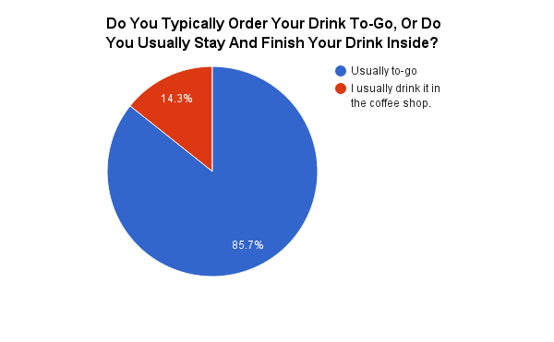
Do You Consume Coffee In the Shop Or At Home?
6 respondents noted
that they consumed
coffee on-the-go (85.7%).
While one noted that
they drink it in shop
(14.3%).

Slide 10
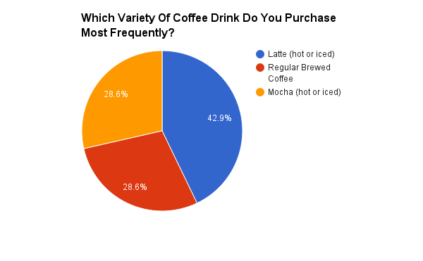
What Type Of Coffee Do You Most Frequently Consume?
Lattes were the most popular response with 3 individuals choosing it.
Regular brewed coffee and mochas tied for second with 2 individuals choosing it.

Slide 11
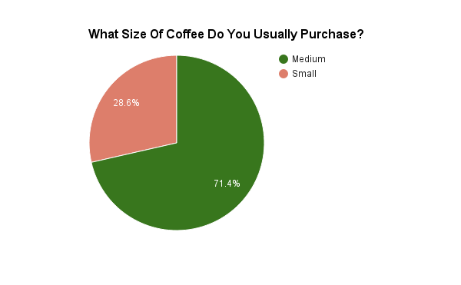
What Size Of Coffee Do You Usually Purchase?

Slide 12
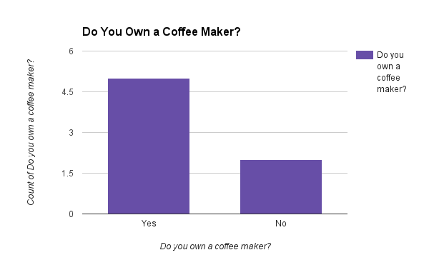
Do You Own A Coffee Maker?

Slide 13
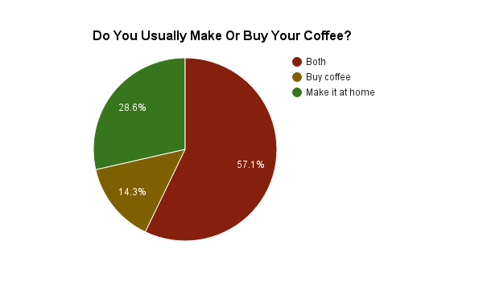
Do You Make Or Buy Your Coffee?

Slide 14
Conclusions
All respondents are coffee consumers.
2 cups of coffee is the average amount consumed in a day.
Caribou Coffee is the preferred coffee shop.
Average amount of money spent on coffee is $5.
The most popular motivation for drinking coffee is to gain energy.

